Slide 1
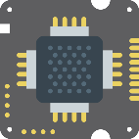
Electronics Systems Design
Conception des systèmes électroniques
Analysis, Designing, Coding and Testing
@authors
ADIKPETO S. S. Ghislain
AMOUSSOU Z. Kenneth
IUT LOKOSSA 2017

Slide 2

Plan
Fundamental of electronic design
Electronic building blocs
Systems designing
Dealing with electronics chips

Slide 3

Fundamental of electronic design
Electronics components, principles and applications

Slide 4

Electronics basis
Elementary components
Resistor
Self
Capacitor
Semi-conductor components
Diode
Bipolar transistor
Unipolar transistor
Etc.
It is really important to master the principle of each of those component to pretend create your own electronic system.

Slide 5
Electronics circuits analysis tools
Fundamental laws
Ohms law
Kirchhoff's Laws
Analysis methods
Nodes methods
Nets methods
Analog/Digital Signal treatment tools
Amplifiers
Filters

Slide 6

Electronic building blocs
Read scientific papers, articles, Theses

Slide 7

Elemental electronic functions
Amplification
Filtering
Oscillator
Regulator
Sensor conditioning circuit
Power source design

Slide 8

Scientific electronic books (1/2)
The library should be your best friend
Analog electronic
Digital electronic
Analog / Digital Signal processing
Microcontroller system

Slide 9

Scientific electronic books (2/2)
Electronic books can be found easily on the web.
Read Datasheet, application note
Read anterior theses (Learn what already exist, only then you can innovate)
Google Scholar is a good friend to look for international papers.

Slide 10

System designing
Simulation versus experimental method

Slide 11

Designing
Electronic circuit design is entirely based on your experience.
Simulation
Draw the circuit in a electronic designing software, then simulate it.
Where could I found component model ?
On the manufacturer web site. You should be asked to subscribe before being able to download models.
Experimental
Draw the circuit on a sheet.
Try it out, check the result, make some changes and start again.
WARNING: You could break some components

Slide 12
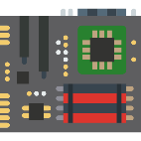
Dealing with IC (Integrated Circuit)
Electrostatic Discharge

Slide 13
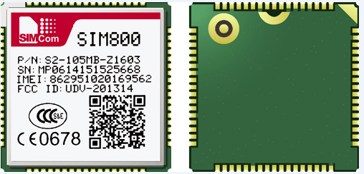
ESD (Electrostatic Discharge)
Electrostatic discharge (ESD) is one of the leading causes of failure in power modules and integrated circuits.

Slide 14


Conclusion
Master electronic components principles and basic applications
Learn electronic fundamental functions blocs
Handle carefully ESD sensitive device or component.
Build your own electronic design box

Slide 15
IUT LOKOSSA, October 2017

